Slide 1

Vel Tech Rangarajan Dr. Sagunthala R&D Institute of Science and Technology
School of Computing
Department of Computer Science and Engineering
10211CS224 / FULL STACK APPLICATION DEVELOPMENT (JAVA)
PROJECT REVIEW : MILESTONE PROJECT – 2
Date: 20-04-2026
Ticket Booking of an Internal Department Event
SDG : SDG 4 – Quality Education and SDG 8 – Decent Work and Economic Growth
Presented By:
STUDENT NAME : SURYATEJA MAROTHU
VTU26090– Reg.No.23UECS1135
Courses Handling Faculty:
Dr. C. M. Chidambaranathan
Associate Professor

Slide 2
INTRODUCTION
Ticket Booking Web Application
The rapid growth of digital technologies has transformed the way events are managed and accessed.
Traditional ticket booking methods are often time-consuming, manual, and prone to errors.
To overcome these limitations, a web-based ticket booking system provides a simple and efficient solution.
This project focuses on designing and developing a React JS-based web application for booking tickets for internal department events such as technical fests, workshops, or seminars.
The application allows users (students or faculty) to:
  View complete event details in one place
  Book tickets online بسهولة and quickly
  Receive instant booking confirmation
The system ensures:
  Real-time tracking of available tickets
  Prevention of overbooking
  Input validation for accurate data entry
1
2
3
4
5
6
7
8
9

Slide 3
PROBLEM STATEMENT
In many educational institutions, the process of booking tickets for internal department events such as technical fests, seminars, and workshops is often handled manually or through unorganized systems. This leads to several challenges, including difficulty in accessing event information, time-consuming registration processes, chances of human error, and lack of real-time updates on ticket availability. Additionally, there is no proper validation of user inputs, which may result in incorrect or incomplete booking details. Overbooking or mismanagement of tickets can also occur due to the absence of an automated tracking system. Therefore, there is a need for a reliable, user-friendly, and efficient web-based application that allows users to easily view event details, book tickets online, ensures proper input validation, and maintains accurate records of ticket availability while providing instant booking confirmation.
1
2
3
4
5
6
7
8
9

Slide 4
OBJECTIVE(S)
The primary objective of this project is to design and develop a user-friendly web-based ticket booking application using React JS for internal department events such as technical fests, seminars, and workshops. The system aims to provide a centralized platform where users can easily view event details including event name, department, date, time, venue, ticket price, and availability. It also focuses on enabling a smooth and efficient booking process by allowing users to enter required details and book tickets instantly, thereby reducing manual effort and saving time.
Another key objective is to ensure accuracy, reliability, and better user experience through proper input validation and real-time updates. The application is designed to prevent overbooking by restricting ticket requests based on availability and to display clear confirmation messages after successful booking. Additionally, the project aims to implement core React concepts such as functional components, state management using hooks, event handling, and conditional rendering, while maintaining clean code structure and simple user interface design for enhanced usability.
1
2
3
4
5
6
7
8
9

Slide 5
PROPOSED SYSTEM
1
Proposed System
Web-based Ticket Booking Application using React JS
Centralized platform to view event details
Displays: Event name, department, date, time, venue, price, availability
Online booking system for students and faculty
Users enter: Name, Email, Department, Number of tickets
Input validation for all fields and email format
Prevents overbooking based on available tickets
Real-time update of ticket availability
Instant booking confirmation with summary
2
3
4
5
6
7
8
9

Slide 6
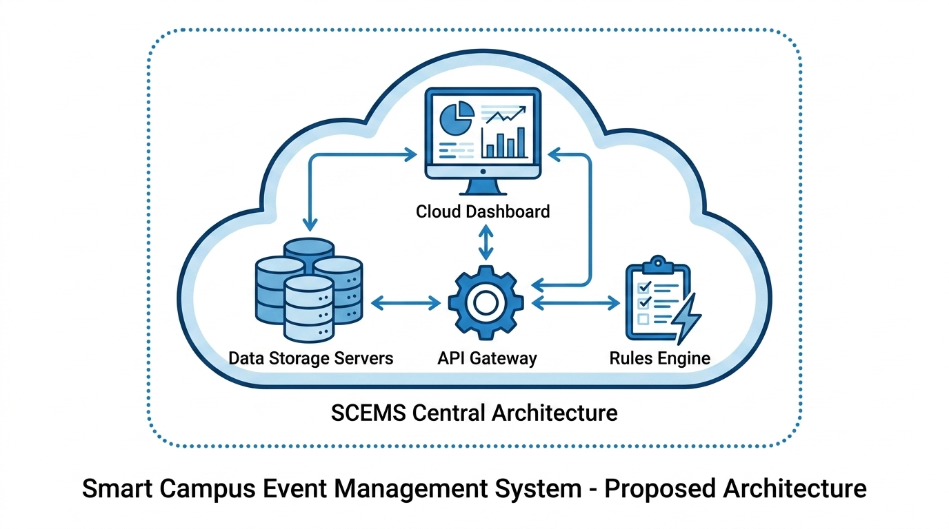
PROPOSED SYSTEM ARCHITECTURE
1
2
3
4
5
6
7
8
9

Slide 7
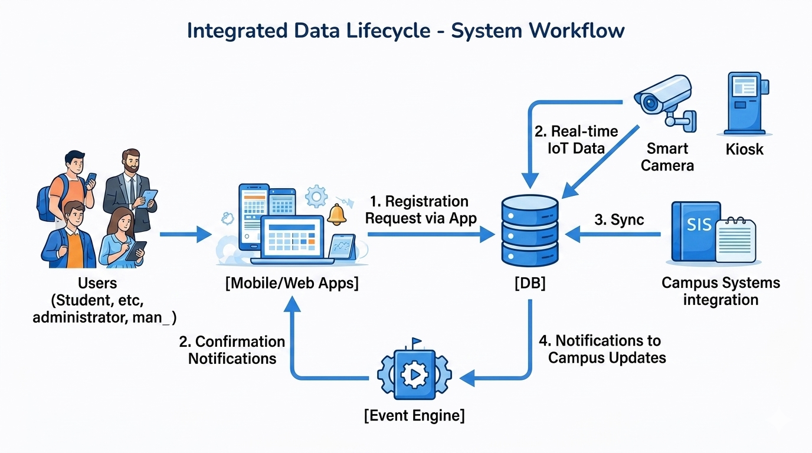
WORKFLOW
1
2
3
4
5
6
7
8
9

Slide 8
TECHNOLOGIES USED
Technologies Used
Frontend:
React JS (Functional Components, JSX)
Programming Language:
JavaScript (ES6)
State Management:
React Hooks (useState)
Styling:
CSS / Basic UI Design
Development Tools:
Visual Studio Code
Browser:
Google Chrome / Any Modern Web Browser
1
2
3
4
5
6
7
8
9

Slide 9
MODULE DESCRIPTION
1. Event Details Module
Displays complete information about the event
Includes: Event name, department, date, time, venue
Shows ticket price and available ticket count
Helps users understand event details before booking
2. Ticket Booking Module
Allows users to book tickets بسهولة
Accepts user inputs: Name, Email, Department, Number of tickets
Calculates total ticket amount automatically
Processes booking request
3. Validation Module
Ensures all fields are mandatory
Validates correct email format
Displays error messages for invalid inputs
4. Availability Management Module
Tracks available tickets in real-time
Prevents booking more tickets than available
1
2
3
4
5
6
7
8
9

Slide 10
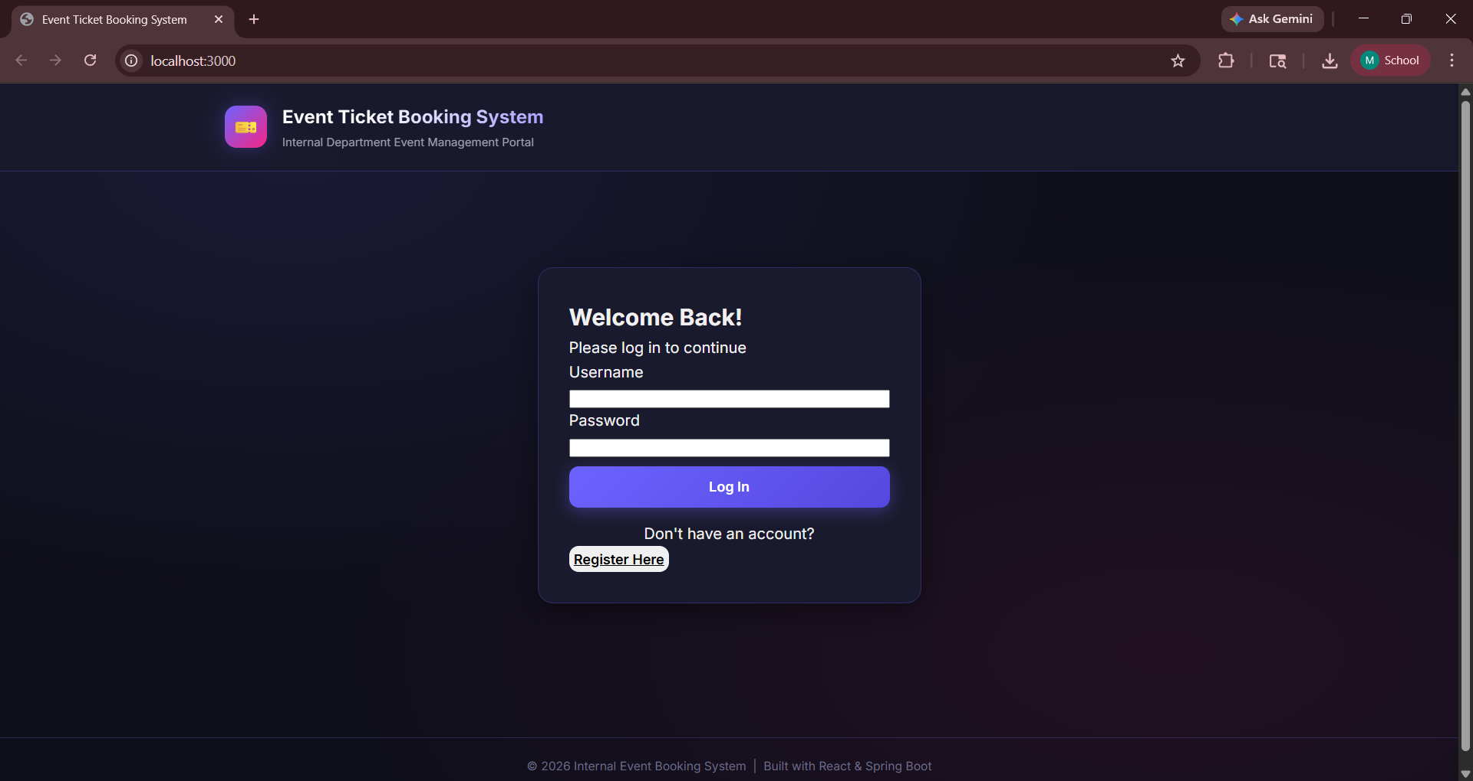
IMPLEMENTATION SCREENSHOTS
LOGIN PAGE :
1
2
3
4
5
6
7
8
9

Slide 11
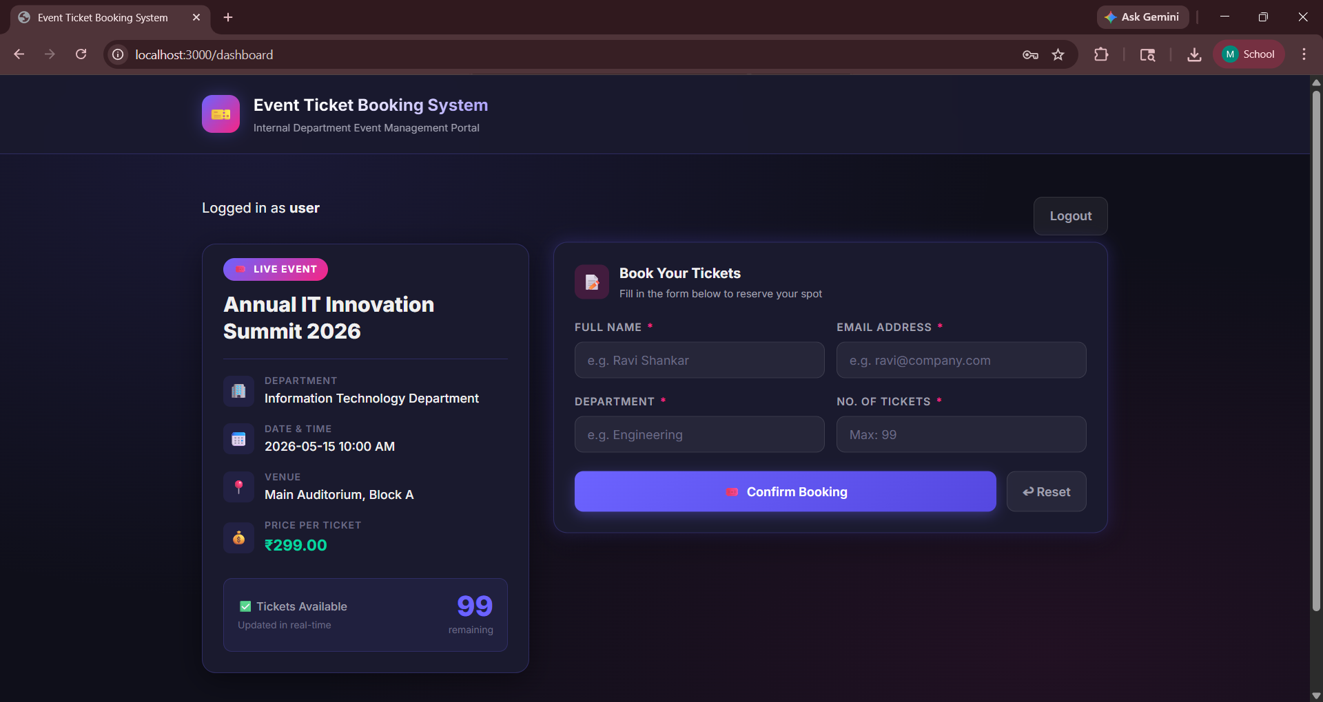
IMPLEMENTATION SCREENSHOTS
HOME PAGE :
1
2
3
4
5
6
7
8
9

Slide 12
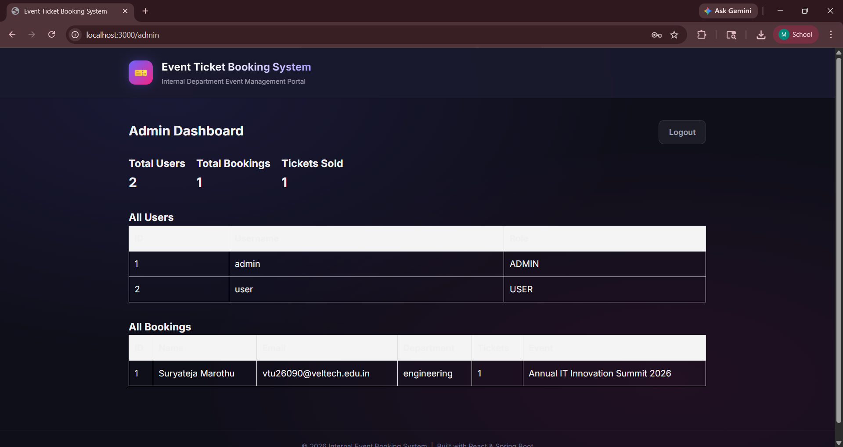
IMPLEMENTATION SCREENSHOTS
ADMIN PAGE :
1
2
3
4
5
6
7
8(A)
9

Slide 13
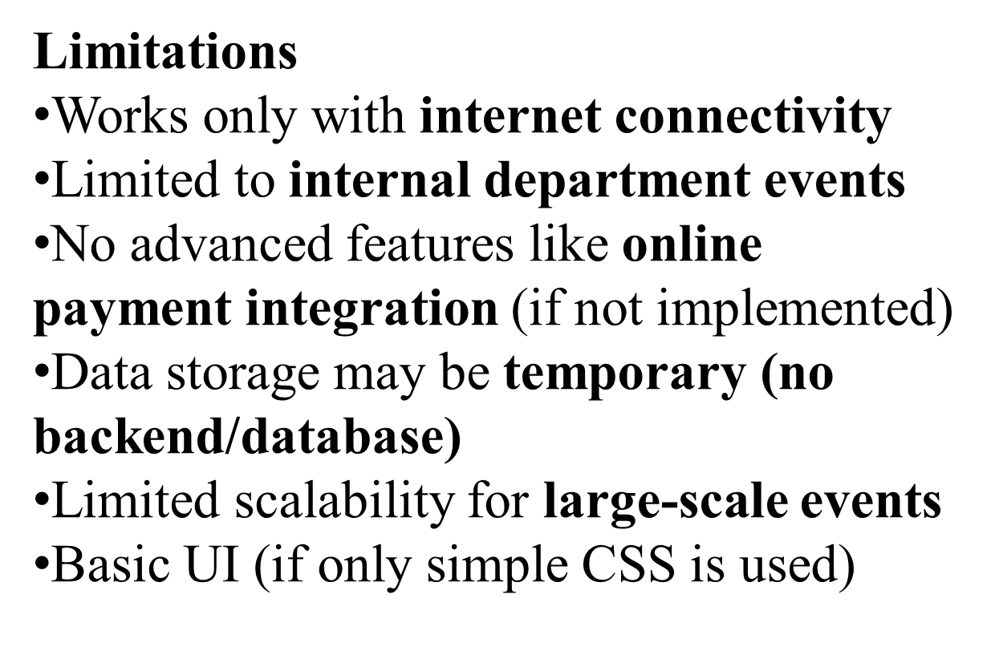
ADVANTAGES & LIMITATIONS
1
Advantages
Easy and quick online ticket booking
Provides real-time ticket availability
Prevents overbooking errors
Ensures accurate data through validation
User-friendly and simple interface
Reduces manual work and paperwork
Instant booking confirmation
Can be accessed from any device with a browser
2
3
4
5
6
7
8
9

Slide 14
Thank you

